Slide 1
Tic Tac Toe
By:- Satyarth Saharsh (RA2111003011244)

Slide 2
What is the Aim?
Aim is to design a simple game of tic-tac-toe developed in Python using Socket Programming. It allows two players to play with one another on different command lines through networking.
The server starts the game by first running server.py, waiting for the client to connect by then running client.py. Once they’re connected, the game itself starts. Socket programming is a way of connecting two nodes on a network to communicate with each other. One socket(node) listens on a particular port at an IP, while the other socket reaches out to the other to form a connection. The server
forms the listener socket while the client reaches out to the server.
2

Slide 3
  Scenario Description
This is a simple game of tic-tac-toe developed in Python. It allows two players to play with one another on different command lines through networking. The server starts the game by first running server.py, waiting for the client to connect by then running client.py. Once they’re connected, the game itself starts. The server starts as "X" and goes first, and the client is "O." The players choose the square they would like to use with coordinates; both "A1" and "1A" would be accepted, for example. The game proceeds, with the players taking turns until one wins or the game is a draw. The host, then the client, is asked whether they'd like a rematch. If both agree, the game starts anew.
  Socket Programming Description
Socket programming is a way of connecting two nodes on a network to communicate with each other. One socket(node) listens on a particular port at an IP, while the other socket reaches out to the other to form a connection. A server has a bind() method which binds it to a specific IP and port so that it can listen to incoming requests on that IP and port.
A server has a listen() method which puts the server into listening mode. This allows the server to listen to incoming connections. And last a server has an accept() and close() method. The accept method initiates a connection with the client and the close method closes the connection with the client.
We use the generic term client to refer to a program that makes use of an implementation. We say that a Python program (a script or a module) that calls a function that is defined in a file named module.py is a client of module This program is similar to the server program, except binding. The main difference between server and client program is, in server program, it needs to bind host address and port address together.

Slide 4
What Socket actually is?
Sockets have a long history. Their use originated with ARPANET in 1971 and later became an API in the Berkeley Software Distribution (BSD) operating system released in 1983 called Berkeley sockets.
When the Internet took off in the 1990s with the World Wide Web, so did network programming. Web servers and browsers weren’t the only applications taking advantage of newly connected networks and using sockets. Client-server applications of all types and sizes came into widespread use.
Today, although the underlying protocols used by the socket API have evolved over the years, and new ones have developed, the low-level API has remained the same. The most common type of socket applications are client-server applications, where one side acts as the server and waits for connections from clients. This is the type of application that you’ll be creating in this tutorial. More specifically, you’ll focus on
the socket API for Internet sockets, sometimes called Berkeley or BSD sockets. There are also Unix domain sockets, which can only be used to communicate between processes on the same host.
Python’s socket module provides an interface to the Berkeley sockets API. This is the module that you’ll use in this tutorial.
The primary socket API functions and methods in this module are:
socket()
.bind()
.listen()
.accept()
.connect()
.connect_ex()
.send()
.recv()
.close()
Python provides a convenient and consistent API that maps directly to system calls, their C counterparts. In the next section, you’ll learn how these are used together.
As part of its standard library, Python also has classes that make using these low-
level socket functions easier. Although it’s not covered in this tutorial, you can check out the socketserver module, a framework for network servers. There are also many modules available that implement higher-level Internet protocols like HTTP and SMTP.

Slide 5
REQUIREMENTS
Requirement Analysis
Laptop/Desktop
Good Internet Connection
AWS Console Access
Socket Libraries of Python
1

Slide 6
Implementation
Server Code-
import socket # for networking
import pickle # for sending/receiving objects
# import the game
from tic_tac_toe import TicTacToe
HOST = '127.0.0.1' # this address is the "local host"
PORT = 12783 # port to listen on for clients
# set up the server
s = socket.socket(socket.AF_INET, socket.SOCK_STREAM) s.bind((HOST, PORT))
s.listen(5)
# accept a connection from the client client_socket, client_address = s.accept() print(f"\nConnnected to {client_address}!")
# set up the game
player_x = TicTacToe("X")
# allow the player to suggest playing again rematch = True
while rematch == True:
# a header for an intense tic-tac-toe match! print(f"\n\n T I C - T A C - T O E ")
1

Slide 7
# the rest is in a loop; if either player has won, it exits
while player_x.did_win("X") == False and player_x.did_win("O") == False and player_x.is_draw()
== False:
# draw grid, ask for coordinate
print(f"\n Your turn!") player_x.draw_grid()
player_coord = input(f"Enter coordinate: ") player_x.edit_square(player_coord)
# draw the grid again player_x.draw_grid()
# pickle the symbol list and send it
x_symbol_list = pickle.dumps(player_x.symbol_list) client_socket.send(x_symbol_list)
# if the player won with the last move or it's a draw, exit the loop if player_x.did_win("X") == True or player_x.is_draw() == True:
break
# wait to receive the symbol list and update it
print(f"\nWaiting for other player...") o_symbol_list = client_socket.recv(1024) o_symbol_list = pickle.loads(o_symbol_list) player_x.update_symbol_list(o_symbol_list)
# end game messages
if player_x.did_win("X") == True: print(f"Congrats, you won!")
elif player_x.is_draw() == True: print(f"It's a draw!")
else:
print(f"Sorry, the client won.")
1

Slide 8
# ask for a rematch
host_response = input(f"\nRematch? (Y/N): ") host_response = host_response.capitalize() temp_host_resp = host_response client_response = ""
# pickle response and send it to the client host_response = pickle.dumps(host_response) client_socket.send(host_response)
# if the host doesn't want a rematch, we're done here if temp_host_resp == "N":
rematch = False
# if the host does want a rematch, we ask the client for their opinion else:
# receive client's response print(f"Waiting for client response...")
client_response = client_socket.recv(1024)
client_response = pickle.loads(client_response) # if the client doesn't want a rematch, exit the loop
if client_response == "N":
print(f"\nThe client does not want a rematch.") rematch = False
# if both the host and client want a rematch, restart the game else:
player_x.restart()
spacer = input(f"\nThank you for playing!\nPress enter to quit...\n") client_socket.close()
1

Slide 9
Client Code-
import socket # for networking
import pickle # for sending/receiving objects # import the game
from tic_tac_toe import TicTacToe
HOST = '127.0.0.1' # the server's IP address
PORT = 12783 # the port we're connecting to # connect to the host
s = socket.socket(socket.AF_INET, socket.SOCK_STREAM) s.connect((HOST, PORT))
print(f"\nConnected to {s.getsockname()}!")
# set up the game
player_o = TicTacToe("O")
# allow the player to suggest playing again rematch = True
while rematch == True:
# a header for an intense tic-tac-toe match! print(f"\n\n T I C - T A C - T O E ")
# draw the grid
player_o.draw_grid()
# host goes first, client receives first print(f"\nWaiting for other player...") x_symbol_list = s.recv(1024)
x_symbol_list = pickle.loads(x_symbol_list) player_o.update_symbol_list(x_symbol_list)
1

Slide 10
# the rest is in a loop; if either player has won, it exits
while player_o.did_win("O") == False and player_o.did_win("X") == False and player_o.is_draw() == False:
# draw grid, ask for coordinate
print(f"\n Your turn!") player_o.draw_grid()
player_coord = input(f"Enter coordinate: ") player_o.edit_square(player_coord)
# draw grid again player_o.draw_grid()
# pickle the symbol list and send it
o_symbol_list = pickle.dumps(player_o.symbol_list) s.send(o_symbol_list)
# if the player won with the last move or it's a draw, exit the loop if player_o.did_win("O") == True or player_o.is_draw() == True:
break
# wait to receive the symbol list and update it print(f"\nWaiting for other player...") x_symbol_list = s.recv(1024)
x_symbol_list = pickle.loads(x_symbol_list) player_o.update_symbol_list(x_symbol_list)
# end game messages
if player_o.did_win("O") == True: print(f"Congrats, you won!")
elif player_o.is_draw() == True: print(f"It's a draw!")
else: print(f"Sorry, the host won.")
1

Slide 11
# host is being asked for a rematch, awaiting response print(f"\nWaiting for host...")
host_response = s.recv(1024)
host_response = pickle.loads(host_response) client_response = "N"
# if the host wants a rematch, then the client is asked if host_response == "Y":
print(f"\nThe host would like a rematch!") client_response = input("Rematch? (Y/N): ")
client_response = client_response.capitalize() temp_client_resp = client_response
# let the host know what the client decided client_response = pickle.dumps(client_response) s.send(client_response)
# if the client wants a rematch, restart the game if temp_client_resp == "Y":
player_o.restart()
# if the client said no, then no rematch else:
rematch = False
# if the host said no, then no rematch else:
print(f"\nThe host does not want a rematch.") rematch = False
spacer = input(f"\nThank you for playing!\nPress enter to quit...\n")
s.close()
1

Slide 12
Game Code
class TicTacToe():
def init (self, player_symbol): # initialize the list of symbols self.symbol_list = []
# defines all nine symbols; all start off as blank for i in range(9):
self.symbol_list.append(" ")
# initializes the player symbol self.player_symbol = player_symbol
def restart(self):
# clears the grid for i in range(9):
self.symbol_list[i] = " " def draw_grid(self):
# display the column headers print("\n A B C\n")
# display first row
row_one = " 1 " + self.symbol_list[0] row_one += " ║ " + self.symbol_list[1] row_one += " ║ " + self.symbol_list[2] print(row_one)
# display divider
print(" ═══╬═══╬═══") # display second row
row_two = " 2 " + self.symbol_list[3]
row_two += " ║ " + self.symbol_list[4] row_two += " ║ " + self.symbol_list[5] print(row_two)
1

Slide 13
# display divider
print(" ═══╬═══╬═══") # display third and last row
row_three = " 3 " + self.symbol_list[6]
row_three += " ║ " + self.symbol_list[7] row_three += " ║ " + self.symbol_list[8] print(row_three, "\n")
def edit_square(self, grid_coord):
# swamps coordinates such as "1A" to "A1" if grid_coord[0].isdigit():
grid_coord = grid_coord[1] + grid_coord[0] # divides the coordinate
col = grid_coord[0].capitalize() row = grid_coord[1]
# converts "A1" to 0, "C3" to 8, and so forth grid_index = 0
if row == "1":
if col == "A": grid_index = 0
elif col == "B":
grid_index = 1 elif col == "C":
grid_index = 2 elif row == "2":
if col == "A": grid_index = 3
elif col == "B": grid_index = 4
elif col == "C": grid_index = 5
elif row == "3":
1

Slide 14
if col == "A": grid_index = 6
elif col == "B": grid_index = 7
elif col == "C": grid_index = 8
if self.symbol_list[grid_index] == " ": self.symbol_list[grid_index] = self.player_symbol
def update_symbol_list(self, new_symbol_list):
for i in range(9):
self.symbol_list[i] = new_symbol_list[i] def did_win(self, player_symbol):
# local variable to replace unweildy self.symbol_list g = []
for i in range(9): g.append(self.symbol_list[i])
# likewise to replace self.player_symbol
sym = player_symbol # check top row
if g[0] == sym and g[1] == sym and g[2] == sym:
return True
# check middle row
elif g[3] == sym and g[4] == sym and g[5] == sym: return True
# check bottom row
elif g[6] == sym and g[7] == sym and g[8] == sym: return True
# check left column
elif g[0] == sym and g[3] == sym and g[6] == sym: return True
# check middle column
1

Slide 15
elif g[1] == sym and g[4] == sym and g[7] == sym: return True
# check right column
elif g[2] == sym and g[5] == sym and g[8] == sym: return True
# check top-right to bottom-left
elif g[2] == sym and g[4] == sym and g[6] == sym: return True
# check top-left to bottom-right
elif g[0] == sym and g[4] == sym and g[8] == sym: return True
# didn't win... yet! return False
def is_draw(self):
# see if all the spaces are used up num_blanks = 0
for i in range(9):
if self.symbol_list[i] == " ": num_blanks += 1
# if the player didn't win and no spaces are left, it's a draw
if self.did_win(self.player_symbol) == False and num_blanks == 0: return True
else:
return False
2

Slide 16
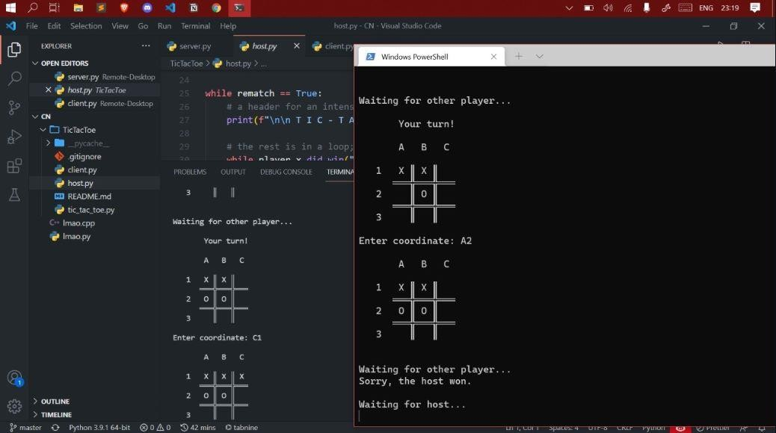
RESULTS
The server and client were started parallelly and then the game code is started to get the expected output.
2

Slide 17
CONCLUSION
To conclude,by using socket programming and some modules of python we have made an efficient and working multiplayer Tic Tac Toe game. A neat communication between client and server gives us the interaction between the two players for the smooth running of the game.
2

